Slide 1
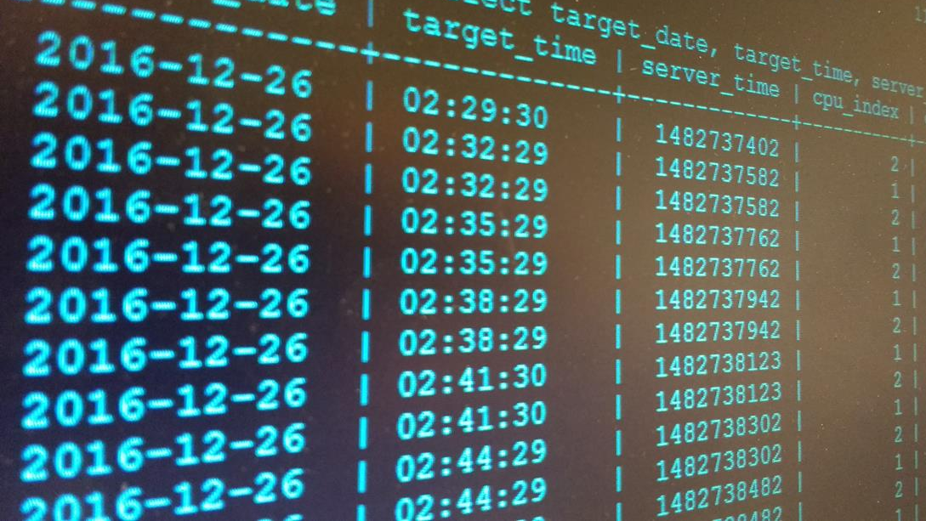
Drugs megastore
Roberto Belmonte
Gonzalo calvo
Laura Cobeña
Jaime viniegra

Slide 2
INDEX:
Summary of our system’s intent
List of our system’s features
E-R diagram
Tables
Progress

Slide 3

System’s intent:
Manage the storage and transactions of drugs inside a company.

Slide 4

STORE
BUY
SELL
PROFIT
Esta foto de Autor desconocido está bajo licencia CC BY-NC-SA

Slide 5
System’s features:
ADD
DELETE
MODIFY
SEARCH
CHANGELOG
SAVE
IMAGE DISPLAY

Slide 6
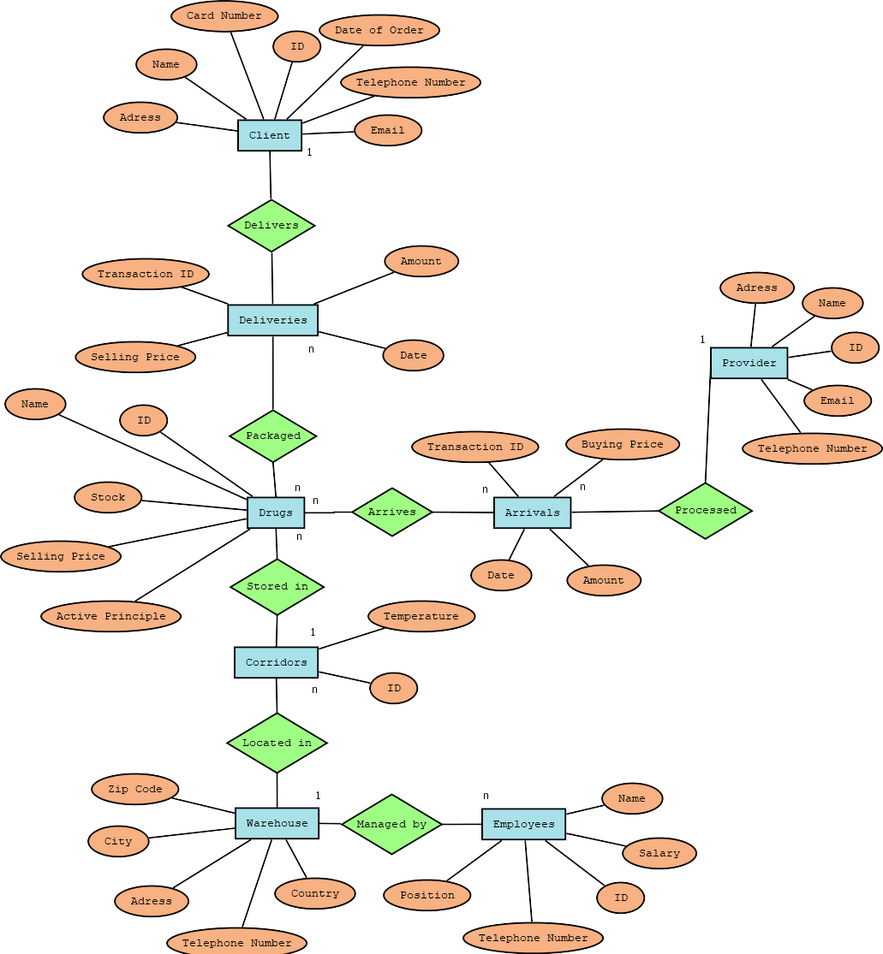
E-r diagram:

Slide 10
Tables
Id | Name | Adress | Telephone number | Email
1 | Bayer | Germany | 888888888 | 56789@bayer.com
2 | Oetker | Dutch | 696969696 | 6567@oetker.com
Provider:

Slide 11
Arrivals:
Arrives:
transaction ID | buying price | date | amount | providerID
1 | 243 | 04/03/2016 | 500 | 1
2 | 67 | 45 | 300 | 2
drug id | transaction id
1 | 1
2 | 2
3 | 2

Slide 12
Drugs:
Package:
ID | Name | Stock | Active Principle | Corridor ID
1 | Aspirin | 5 | monkey.... | 1
2 | Ibuprofeno | 30 | donkey | 2
3 | Omeoprazol | 45 | cat | 3
drug id | transaction id
1 | 1
2 | 2
3 | 2

Slide 13
Deliveries:
transaction id | selling price | amount | date | client_id
1 | 10 | 500 | 12/10/2017 | 1
2 | 30 | 500 | 12/10/2017 | 02/01/1900

Slide 14
Client:
Id | Name | Adress | Telephone number | Email | Payment Method
1 | H. La Paz | avndda | 3456789 | @.com | paypal
2 | farmacia "Paca" | avenida | 4567845

Slide 15
Corridor:
Warehouse:
Id | Temperature | Warehouse ID
1 | 25C | 1
2 | 10C | 1
3 | 15C | 2
Id | Phone | Country | Address | PC
1 | 1234567 | España | Avnd asd | 19023
2 | 234 | España | MUrcia | 29082
ID | Name | Salary | Phone | Position | Warehouse ID
1 | PACO | 32 € | 3456 | Currito | Currito
Employee:

Slide 16

PROGRESS

